Slide 1
Alumnae Information Services
Karen Corday, Director of AIS

Slide 2
What Does AIS Do?
Mission
To maintain, collect, and administer alumnae information that is accurate, up-to-date, useful, and reusable and to use this information to support the Alumnae Association’s operations, mission, vision, and goals.
Services for Volunteers
Pulling lists, including contact lists, volunteer lists, and mailing labels
Sending broadcast emails and print mailings on behalf of clubs and classes
Keeping the Alumnae Directory and Career Directory accurate and up-to-date
Providing monthly regional address change reports

Slide 3
Alumnae Privacy
Alumnae Association Privacy Policy
The Association makes alumnae contact information available exclusively to the Mount Holyoke College alumnae community via a password-protected login. Only Mount Holyoke College alumnae, faculty, and staff have access to the Alumnae Directory, while alumnae, faculty, staff, and students have access to the Career Directory. Alumnae can choose what they would like displayed in the directory for others to see.
Alumnae Lists
Contact and volunteer lists may only be shared with class, club, and committee volunteers and members of the Association’s Board of Directors.
It is important to request a new list each time you send a club or class communication. We receive updated contact and other alumnae information every day; a fresh list is the only way to guarantee that you are using the most up-to-date information to contact your constituents.
Conversely, if you hear of or receive updated contact or other information about a fellow alumna, please pass it along to us at ais@mtholyoke.edu or call us at 413-538-2303. We rely on our volunteers to help us keep things current!

Slide 4
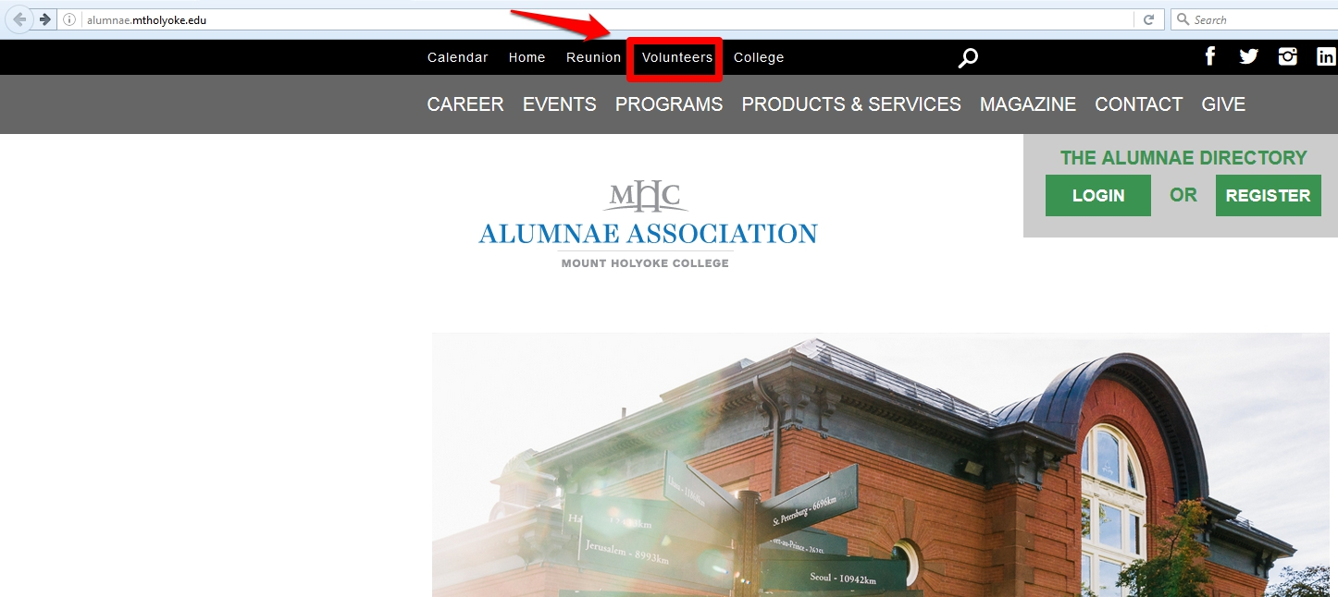
Information Request Form

Slide 5
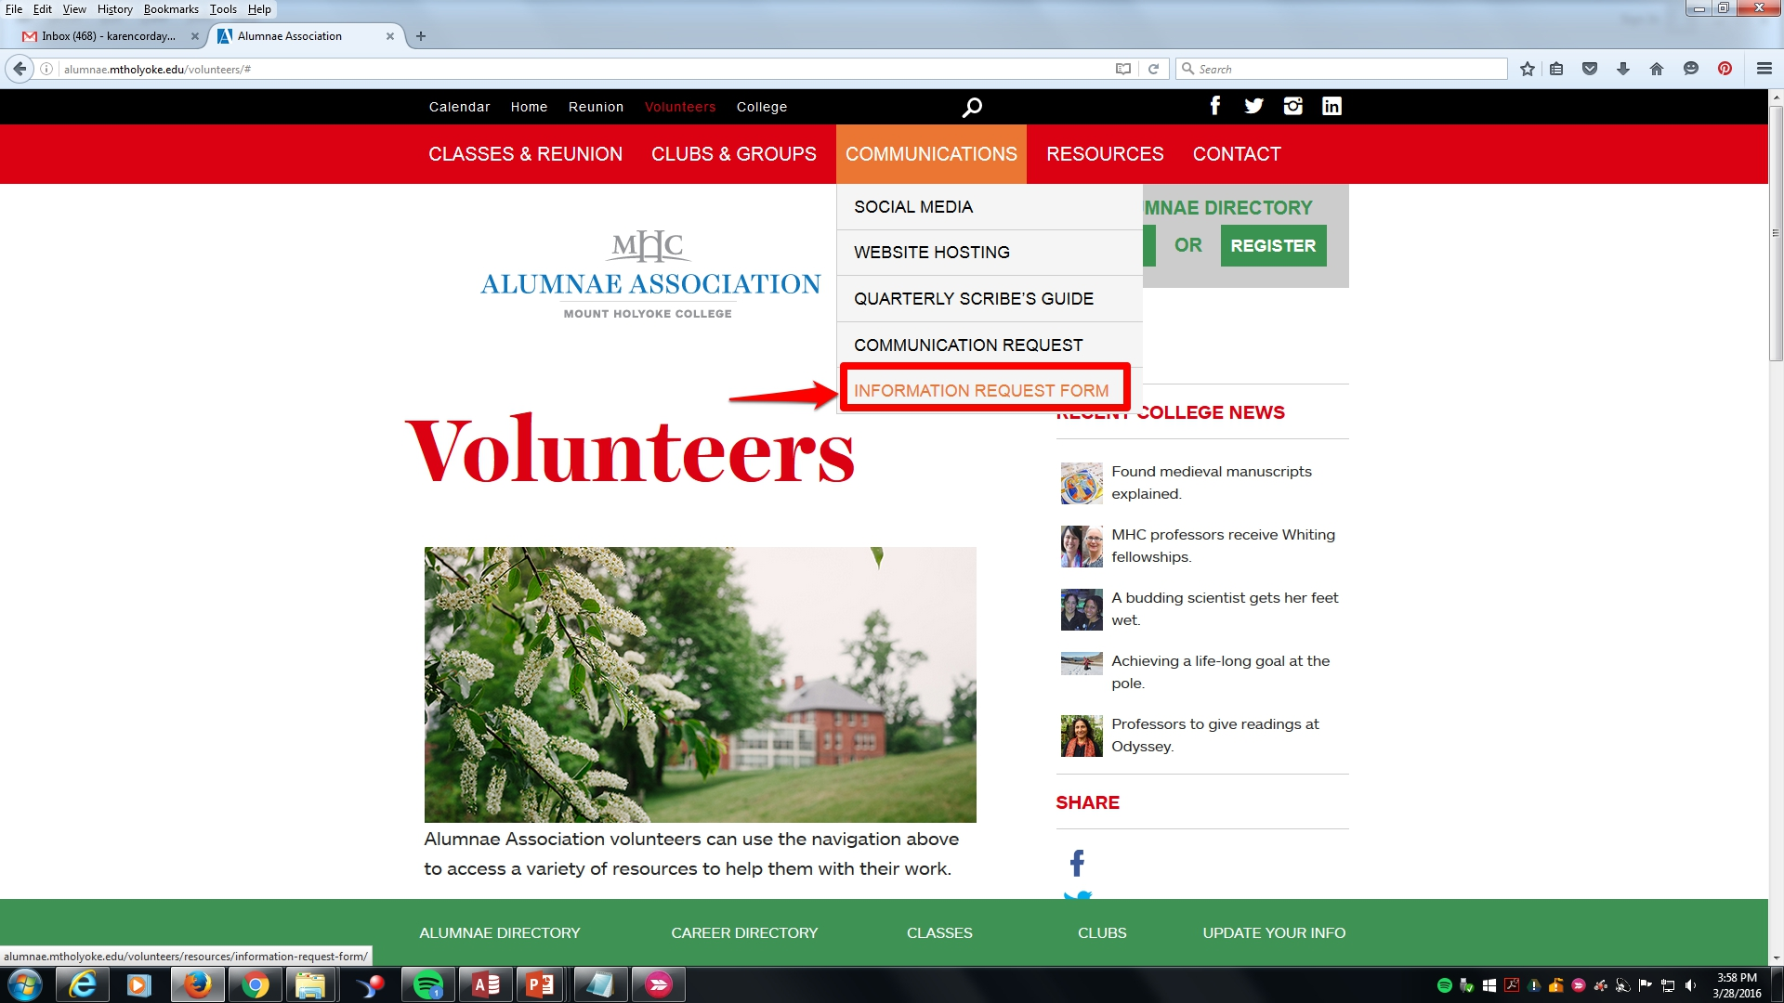
Information Request Form, cont.

Slide 6
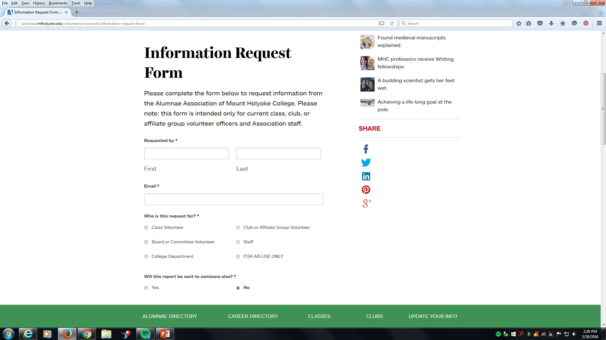
Information Request Form, cont.

Slide 7
Information Request Form, cont.
Allow five business days for processing
AIS receives an average of 90 information and communication requests each month.
The reports aren’t automated; we manually run a new one every time.
If there is a special situation, write to ais@mtholyoke.edu or call 413-538-2303. We can expedite your request, answer questions, etc.
Reminder: PLEASE do ask for a fresh list every time you are using it to communicate with people!
Don’t make manual edits to your old lists using the monthly address change reports; those are purely for notification purposes, e.g. to reach out and welcome new members of your club.
Another option: Communication Requests!

Slide 8
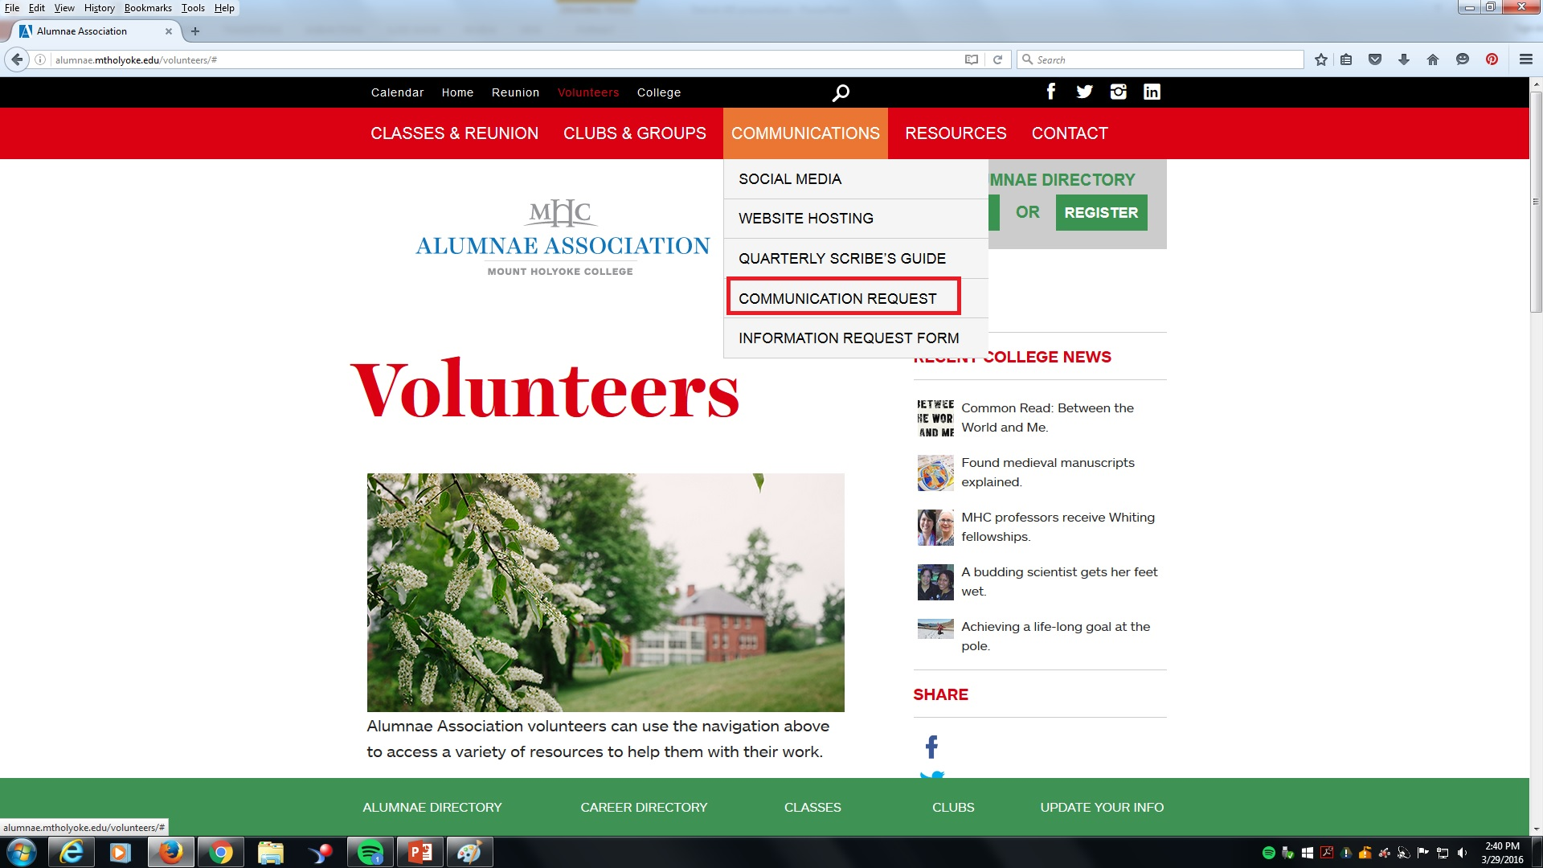
Communication Request Form

Slide 9
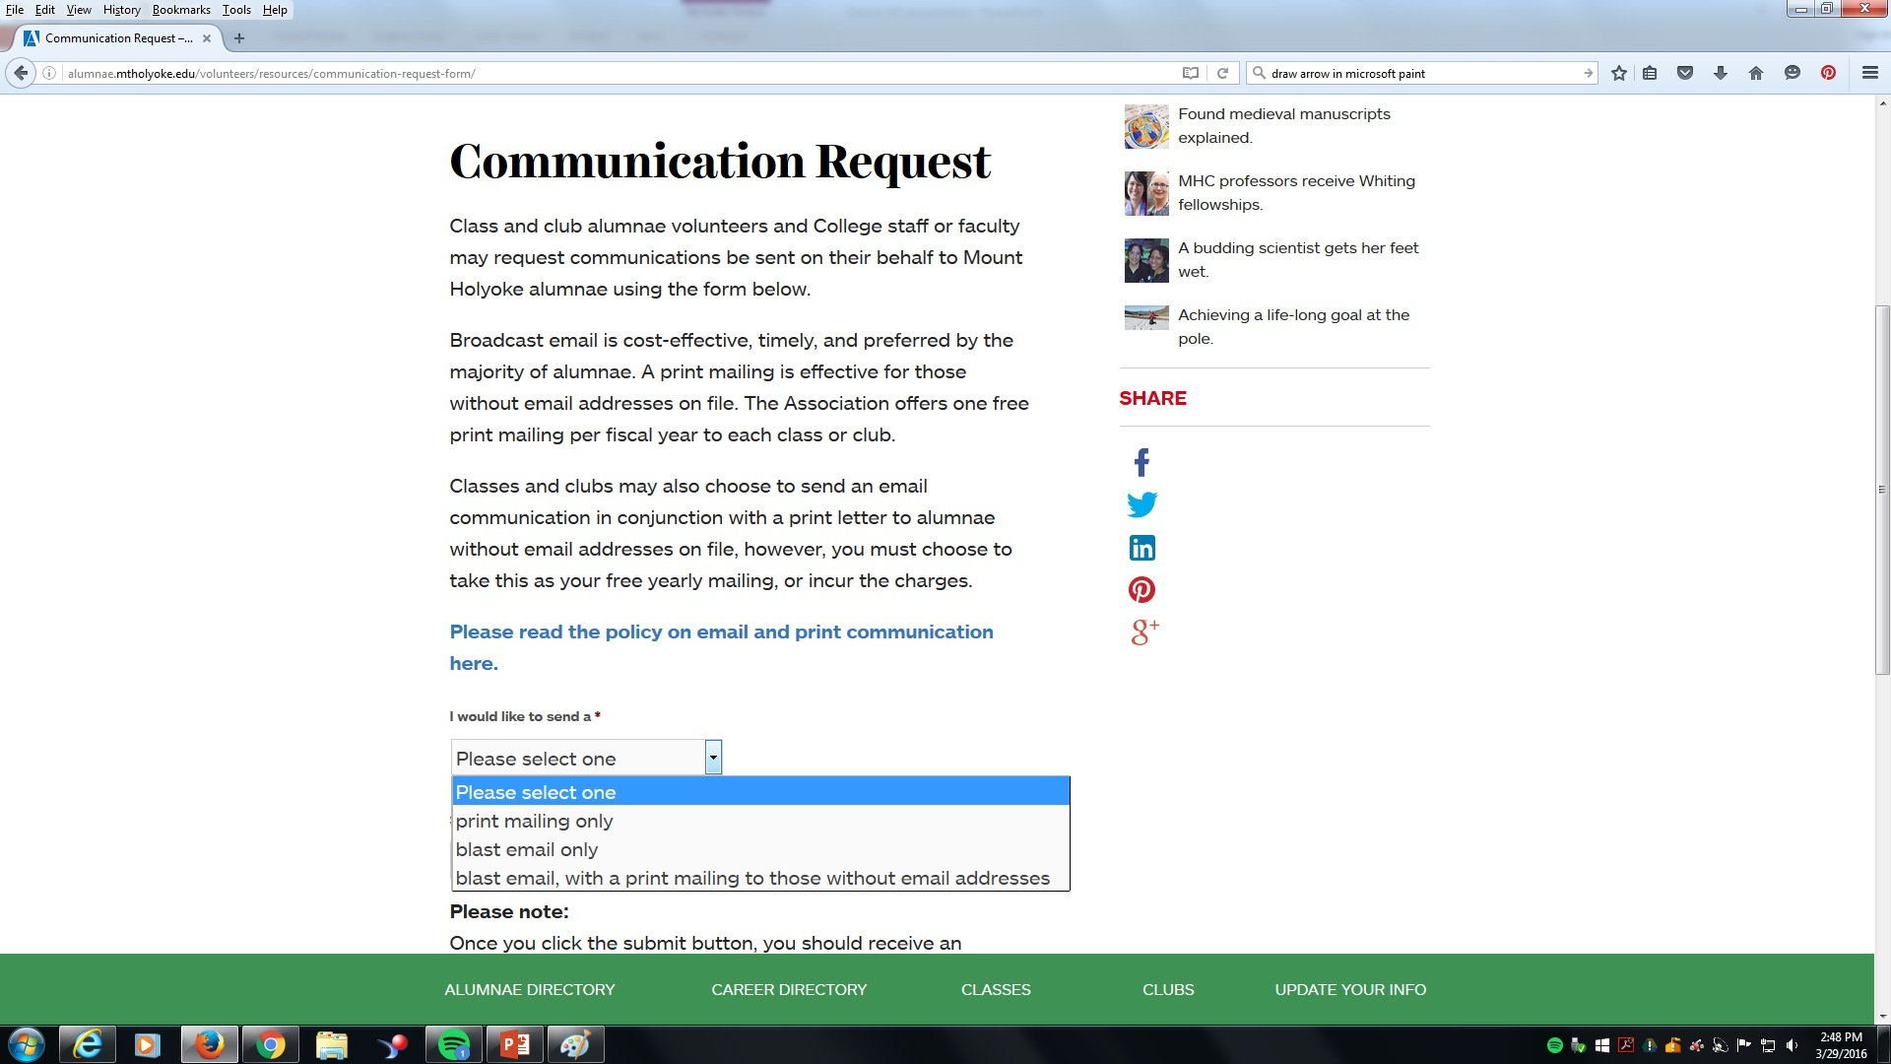
Communication Request Form, cont.

Slide 10
Communication Request Form, cont.
Allow five business days for processing.
Broadcast emails: cost-effective, timely, preferred by most alumnae.
We send the email, but the reply-to-email address is yours.
Messages longer than 1000 words will be formatted as a PDF link within the email.
Print mailings: One free print mailing per fiscal year per club or class. Sent via bulk mail. Additional mailings will be billed to the club or class.

Slide 11
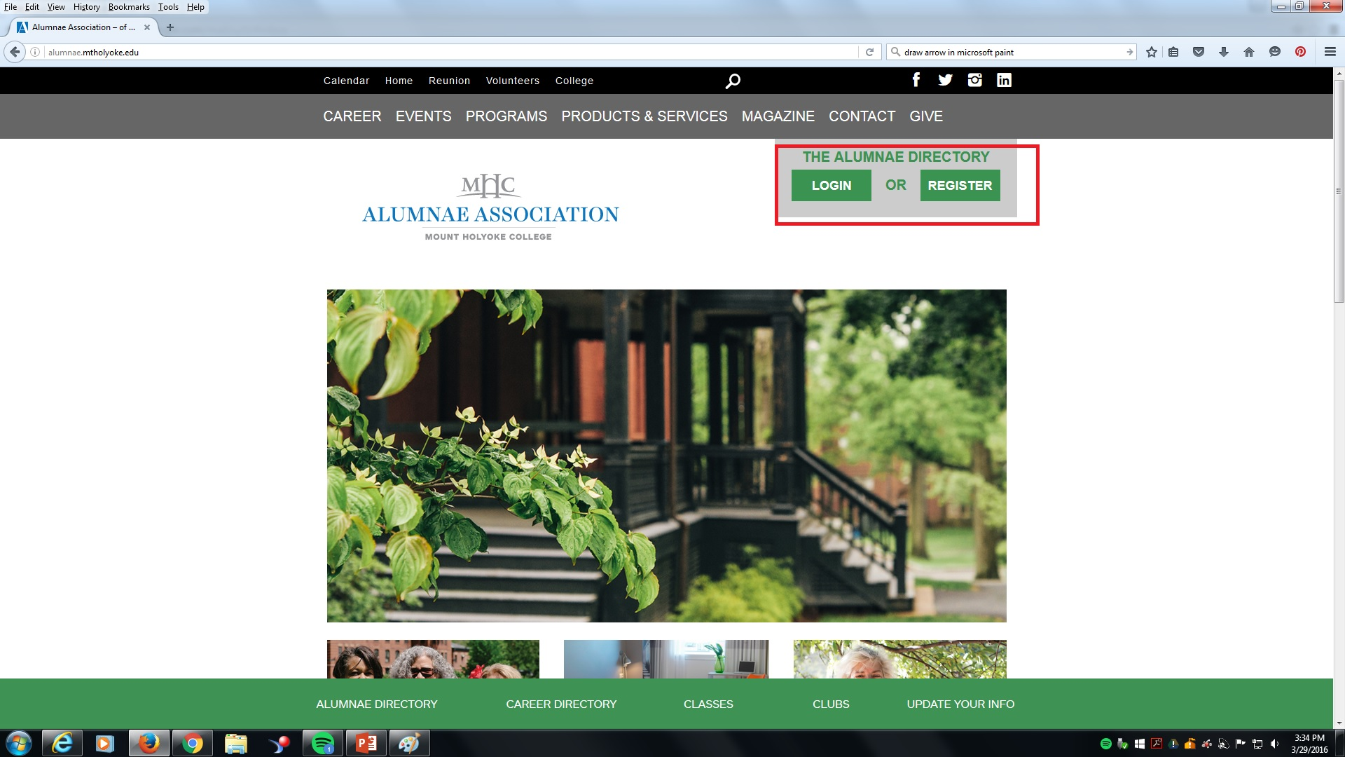
Searching the Alumnae Directory

Slide 12
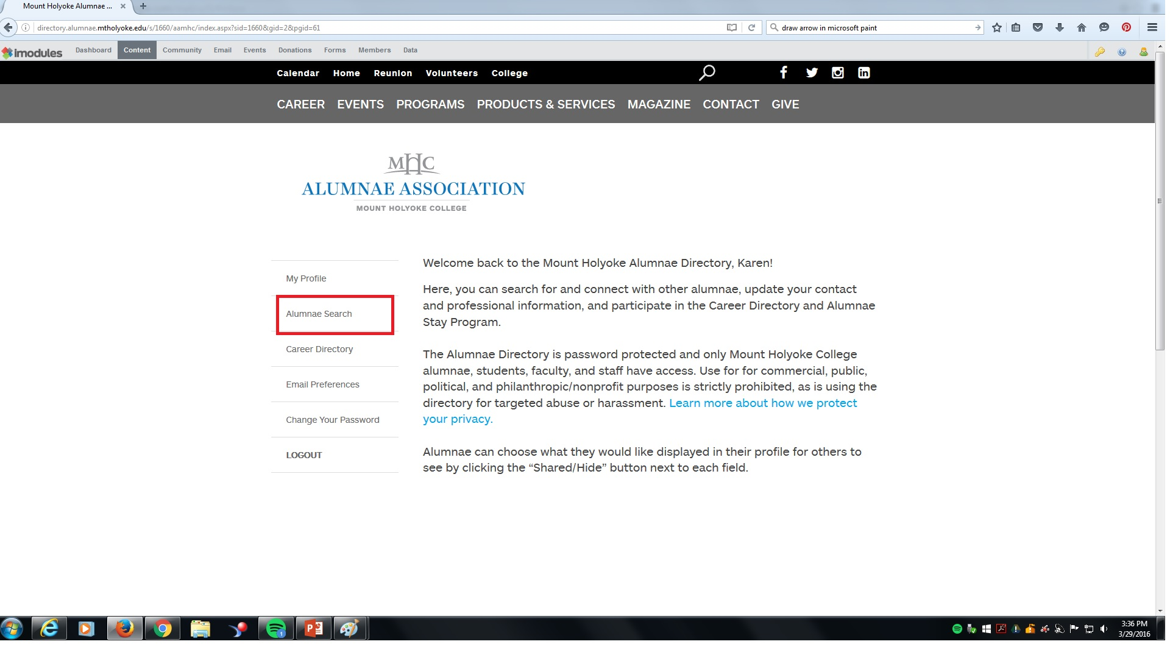
Searching the Alumnae Directory, cont.

Slide 13
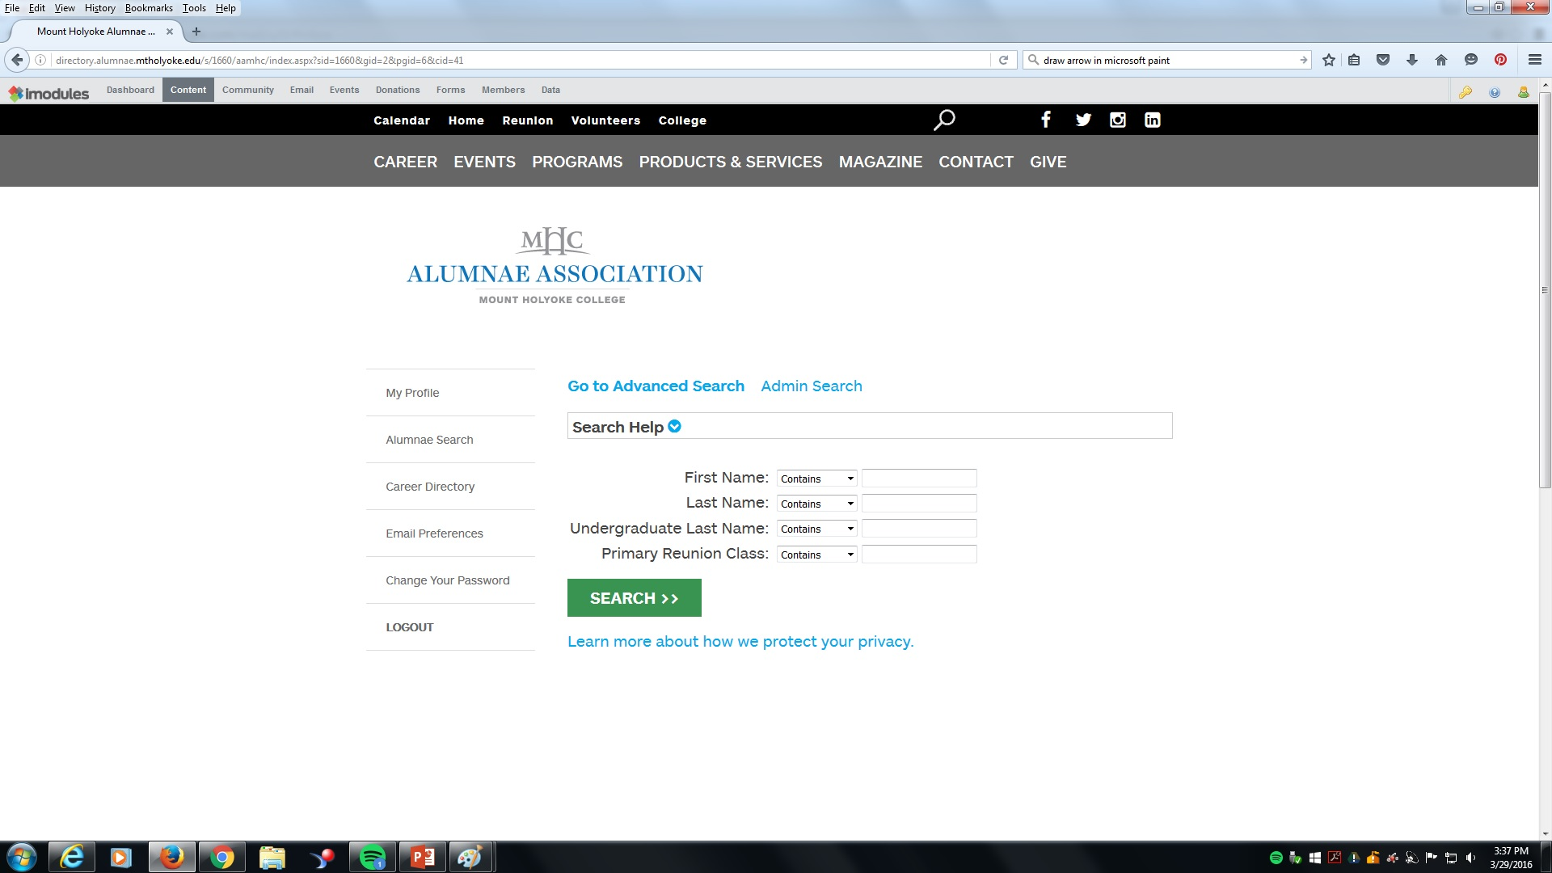
Searching the Alumnae Directory, cont.
Simple search:

Slide 14
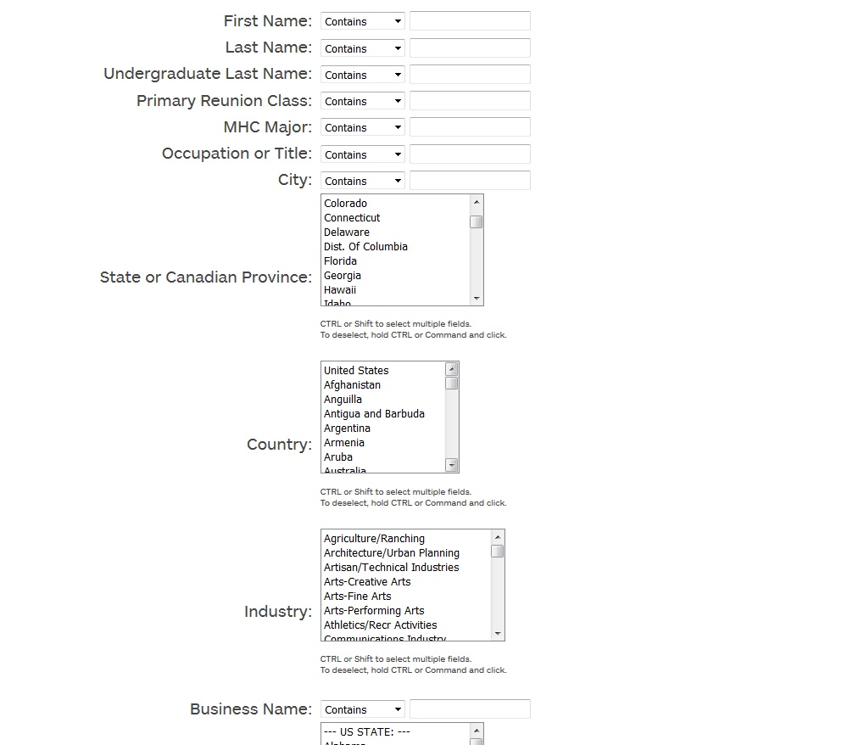
Searching the Alumnae Directory, cont.
Advanced search:

Slide 15
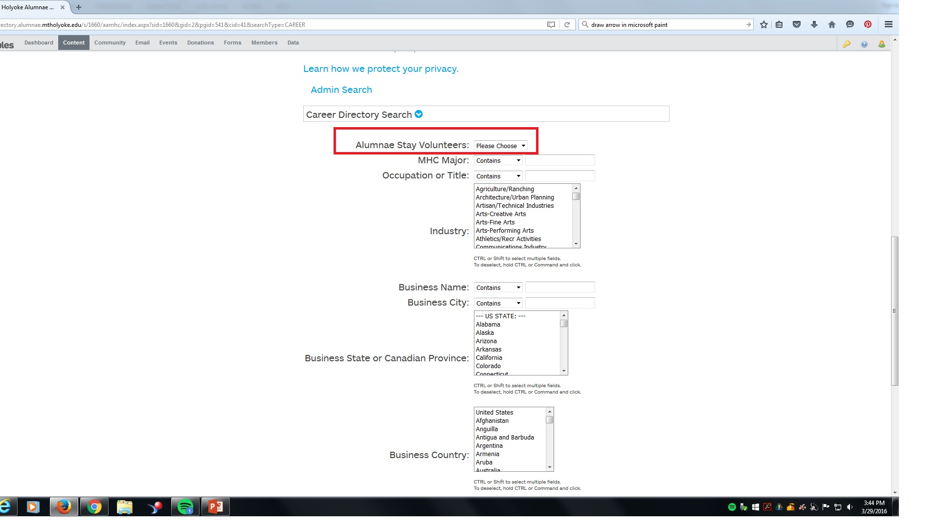
Using the Career Directory
Alumnae Stay

Slide 16
Contact Alumnae Information Services
Karen Corday
kcorday@mtholyoke.edu
413-538-2737
Alumnae Information Services
ais@mtholyoke.edu
617-538-2303

