Slide 1

Building Alumnae Engagement
Marketing & Communications

Slide 2
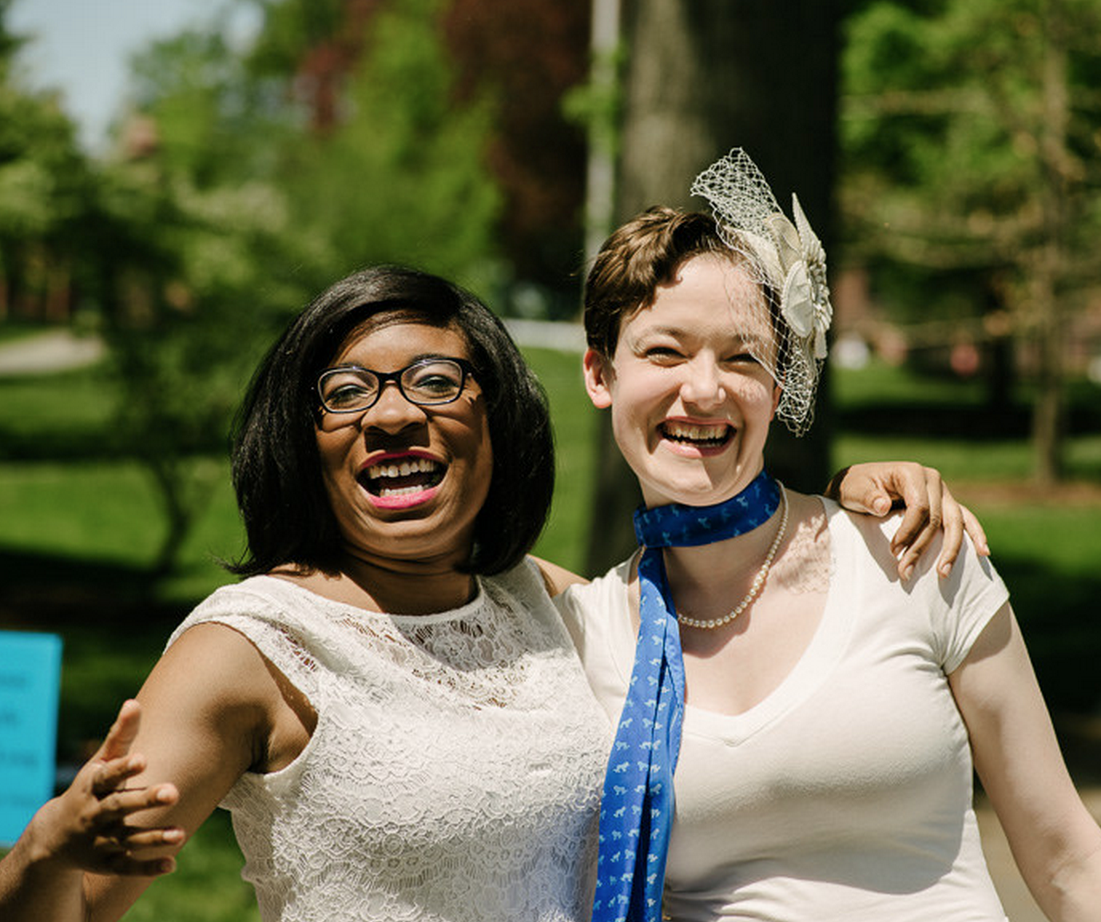
Overview
Ways the Association supports club efforts.
Tips and best practices to reach your members through marketing and communications.
Highlight clubs that are optimizing their channels to engage alumnae.

Slide 3
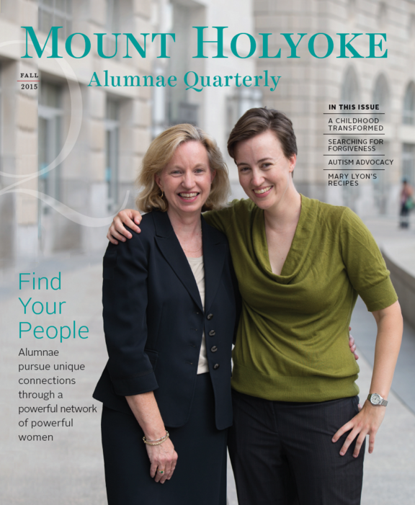
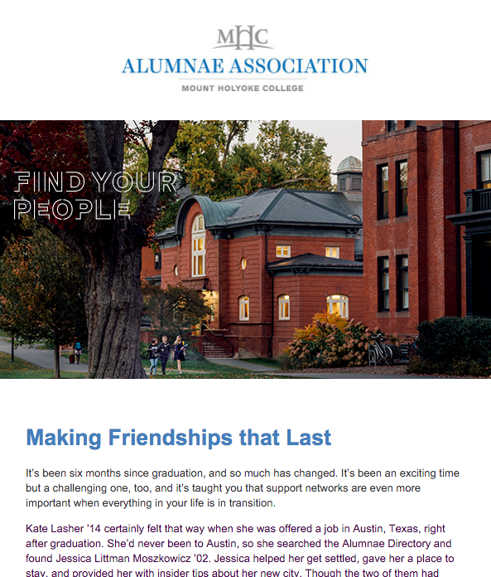
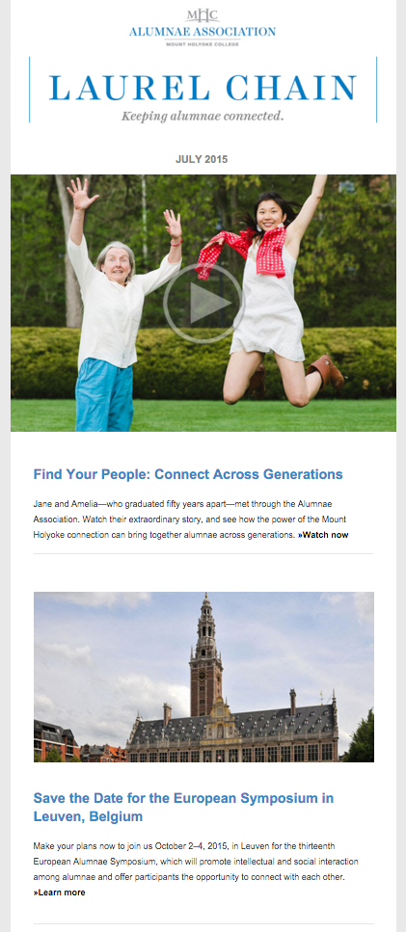
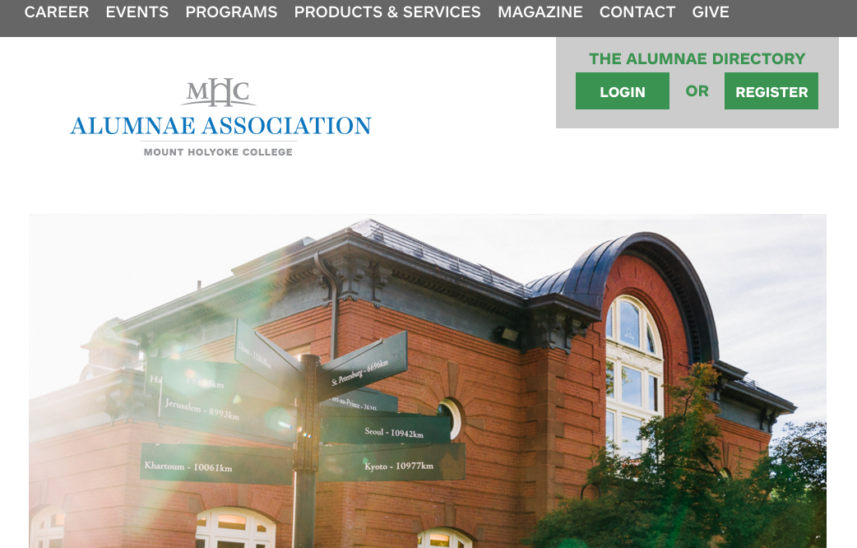

Association Channels
Laurel Chain enewsletter
Sends to ~24,000 alums
Broadcast Email
~24,000 addresses
Avg. open rate 34%
Alumnae Quarterly
Mails to ~33,000 alums
Association Social Media
Facebook ~10,500
Twitter ~3,100
LinkedIn ~7,200
Instagram ~2,100
Association website ~150,000 visitors/year

Slide 4
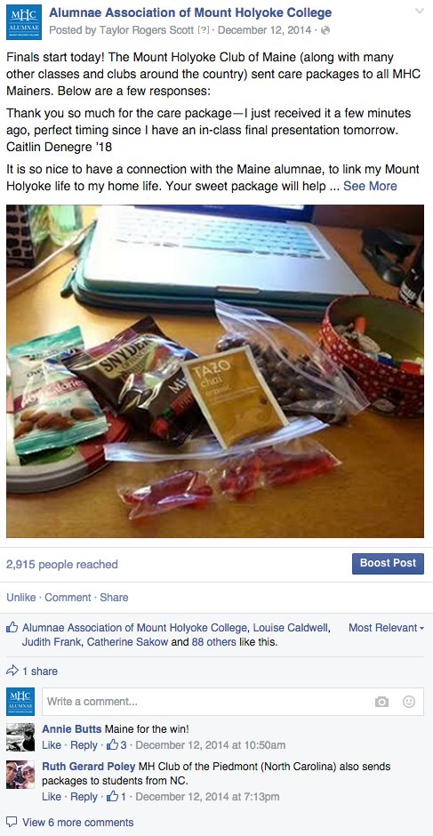
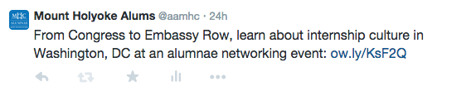
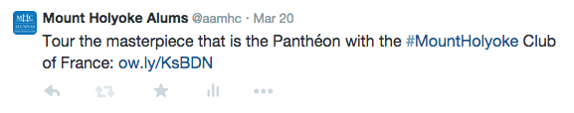
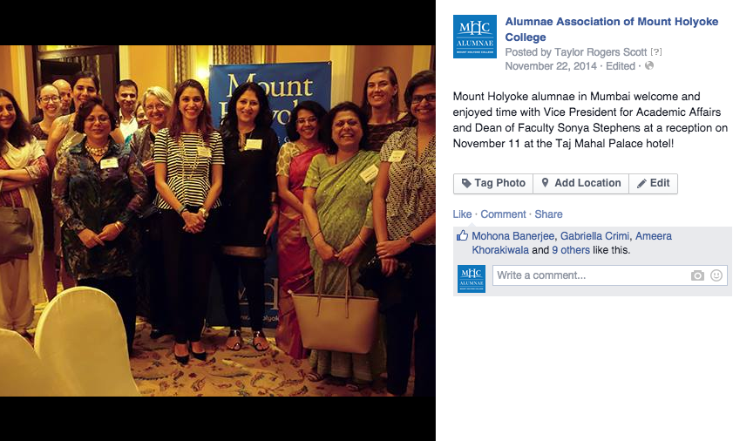
Supporting Clubs
Social Media

Slide 5
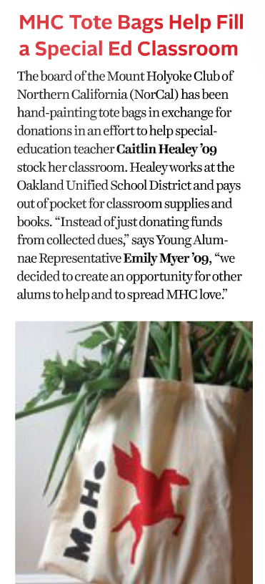
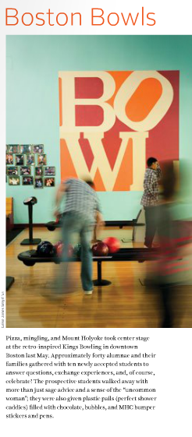
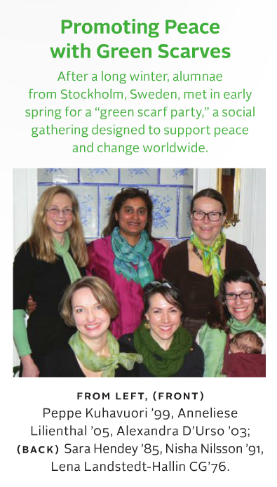
Supporting Clubs
Alumnae Quarterly

Slide 6
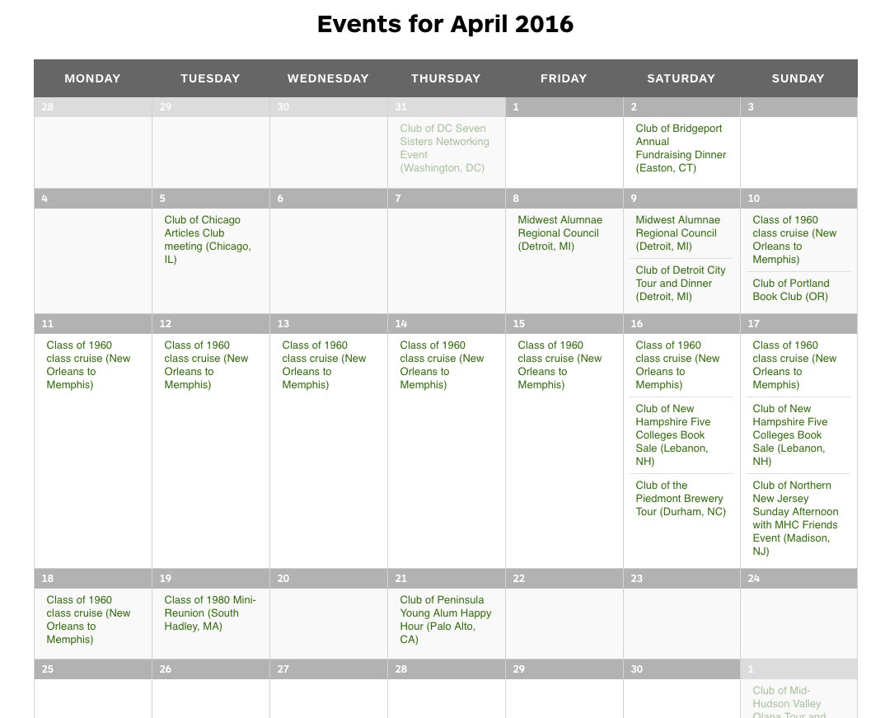
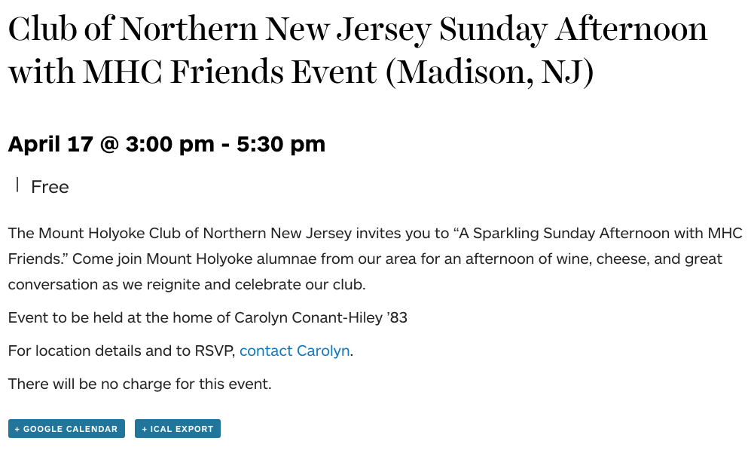
Supporting Clubs
Website Calendar

Slide 7
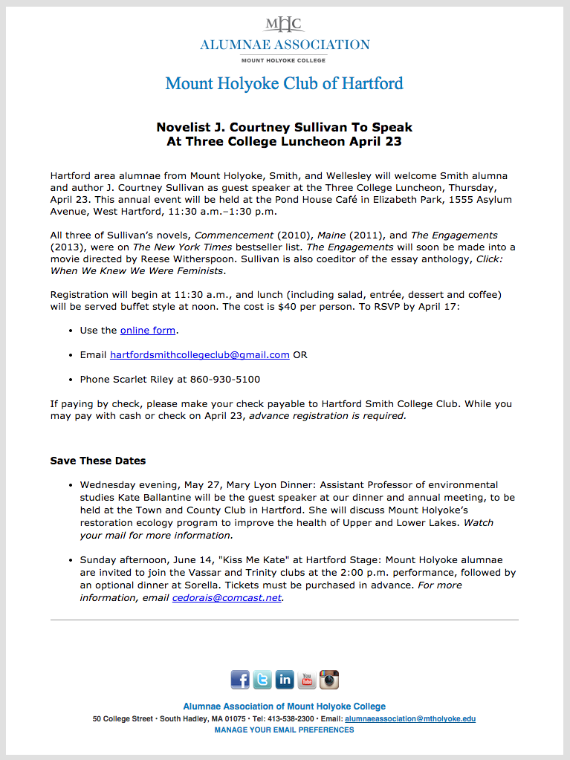
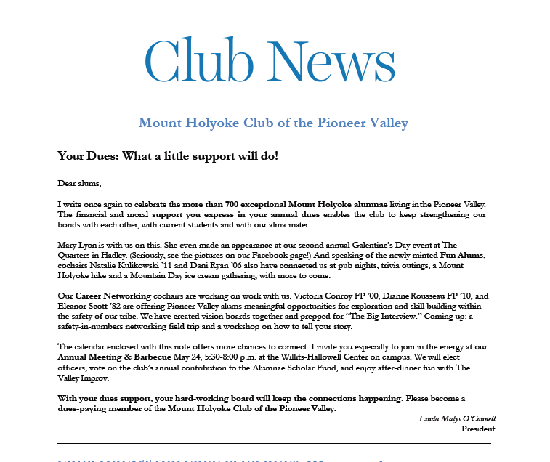
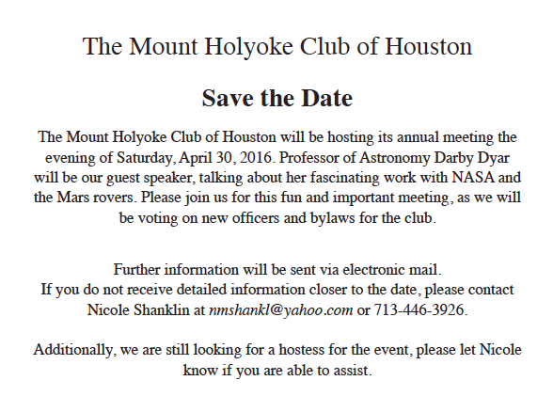
Supporting Clubs
Broadcast Email & Print Letters

Slide 8
Promoting Your Club Activities

Slide 9
Do You Really Need a Website?
Websites aren’t for everyone
They take a lot of care and feeding and are not destinations for alumnae in general.
Consider a Facebook page instead
Can house the same information as a website.
Added benefit: can push out to all followers.
Please note: you do not have to have an account in Facebook to access an FB page
Websites should be clean, simple, and evergreen
Club board
Dues payment
Contact information
Links to social media
Event listings if time to keep updated

Slide 10
Ways to Reach Your Classmates
Pages
Groups
Connect organizations with their “fans”
Are public and show up in search engines
Can send updates
Have tabs/applications that uncover more information
Set up for more personal interaction
Can be set to “open” or “closed”
Can send direct messages
Events
Purchase ads

Slide 11
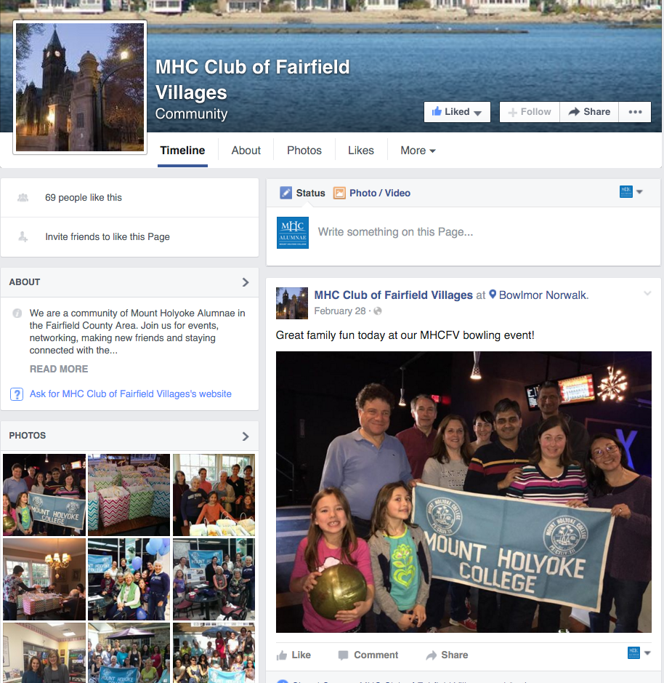
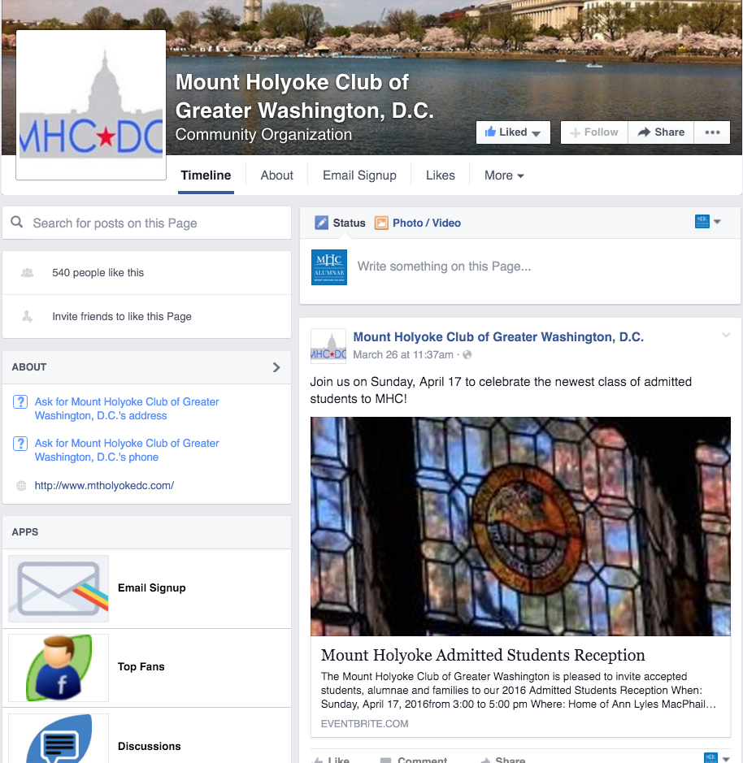
Steal from the Best
Social Media
facebook.com/MHCClubOfFairfieldVillages
facebook.com/MHCDC

Slide 12
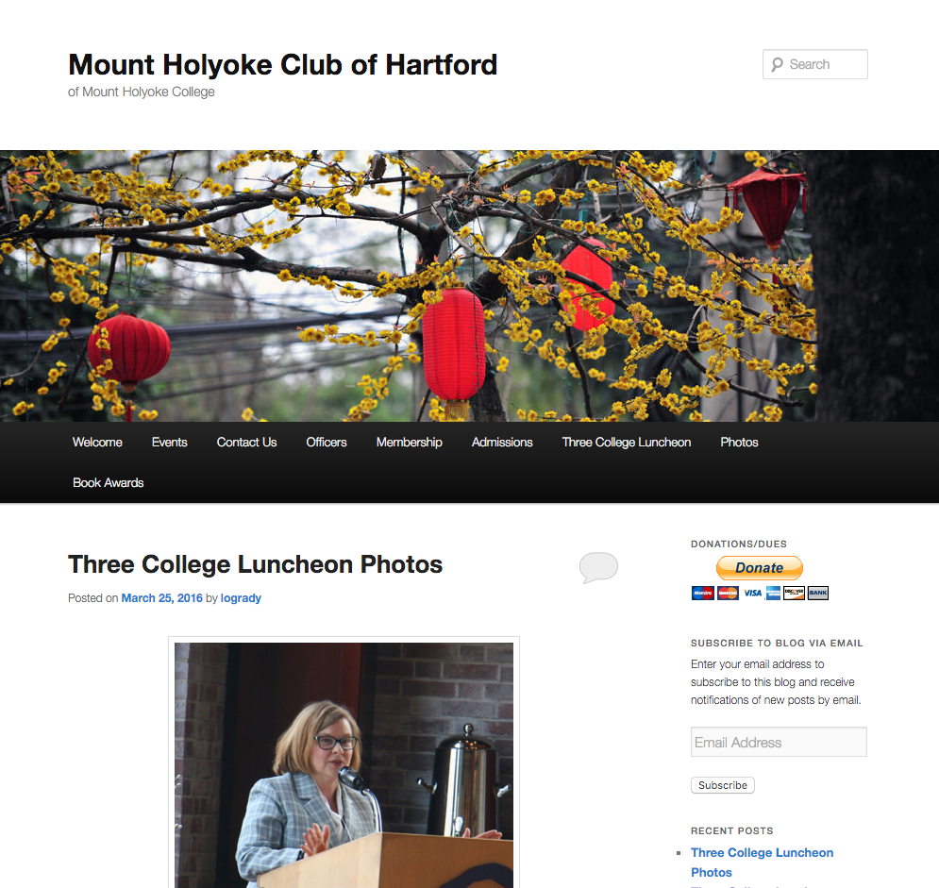
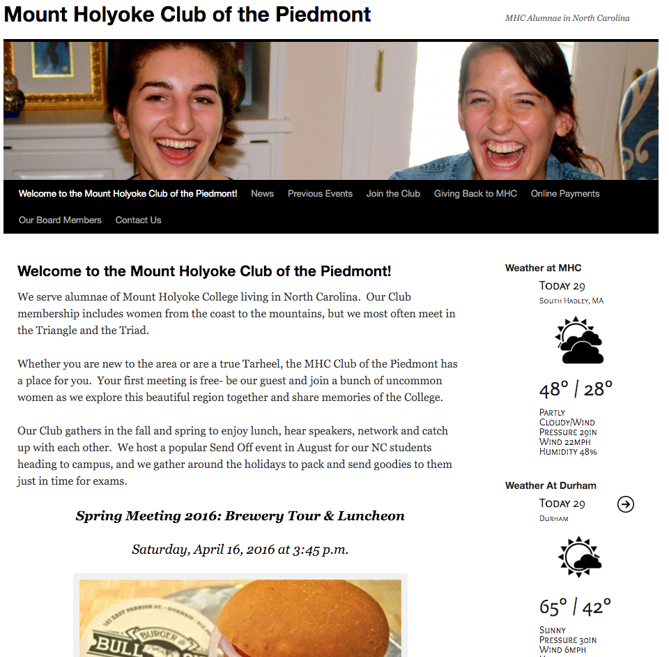
Steal from the Best
Websites
sites.alumnae.mtholyoke.edu/wp/hartford
sites.alumnae.mtholyoke.edu/wp/piedmont

Slide 13
Takeaways
Publish once, promote everywhere
Post event/news/updates on Facebook or your website and then push out through all of your channels: social, email, print newsletters, announcements at events
Use MHC’s Flickr accounts for photos for your website or Facebook page: flickr.com/aamhc or flickr.com/mhc

Slide 14
Takeaways
Post on social media at least 1x per week
Create Facebook events for every event you hold and invite your members
Shorter posts do better
Photos perform 53% better than other types of posts.
Posts with questions garner 100% more comments than those without.
When out of ideas, steal! Repost the College or Association news.

Slide 15
Takeaways
Send an email and/or letter at least quarterly:
Keep emails short. Average read time is 15 seconds. Link to website or Facebook page where you house all the details.
Remind classmates of your social channels in every single email
Don’t just remind about upcoming events; report on the success of past events to entice new attendees.

